Slide 1


Interactive Data Kung Fu with Shaolin
Guillem Duran Ballester

Slide 2

@Miau_DB
Guillem-db

Slide 3
what is this about?
Shaolin
Not a Tutorial
Introduction
- Core capabilities
- Demo videos
- Call for help
Notes:
Shaolin is a new python library that allows for easily adding a layer of interactivity to a python object when using the jupyter notebook.
This will not be a tutorial but an introduction to some of the main capabilities of shaolin
alongside some real examples in which shaolin has been used to build a graphic user interface.
And of course, the final goal of this talk is just to convince you to use shaolin and create a community around it to make it grow.

Slide 4
How am I presenting it?
The Ways of Data Kung Fu!
Science
Martial arts
Hacking
Teaching
Notes:
We will basically talk about “Data Kung Fu”. the philosophy behind Shaolin and its features, inspired by science, hacking, teaching and martial arts...

Slide 5
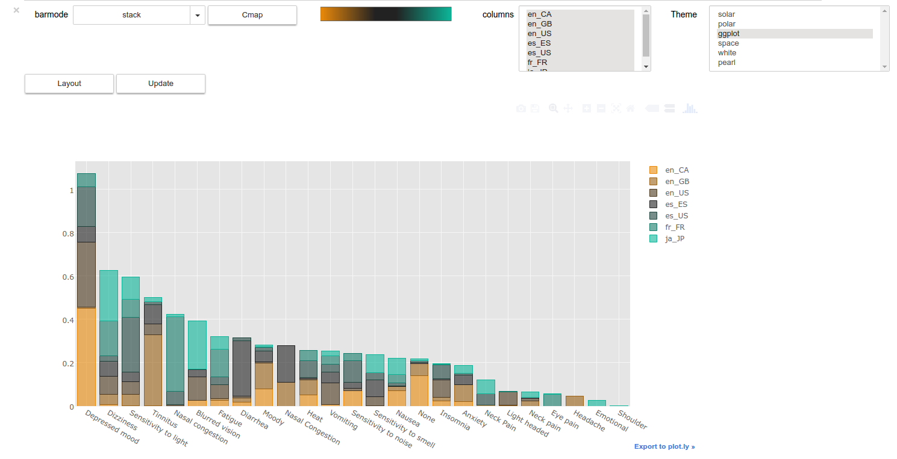
And dashboards!
Notes:
In order to build interactive dashboards

Slide 6
SHAOLIN
Structure Helper for dAshbOard LINking
Notes:
Shaoling stands for […] but of course it is also called this way because...

Slide 7
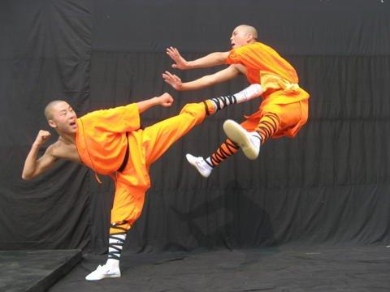
Helps you perform some nice Data Kung Fu!
Notes:
Shaolin […]

Slide 8

Data Kung(Man) Fu (Work)
Notes:
Data kung fu translates as mastering data through hard work and practice

Slide 9
What is it?
Notes:
So what is it

Slide 10
Just our way of working
Notes:
This is just our way of working

Slide 11
Why?
Notes:
It all started as a way to let my boss play with our strange algorithms without having to actually learn python.

Slide 12
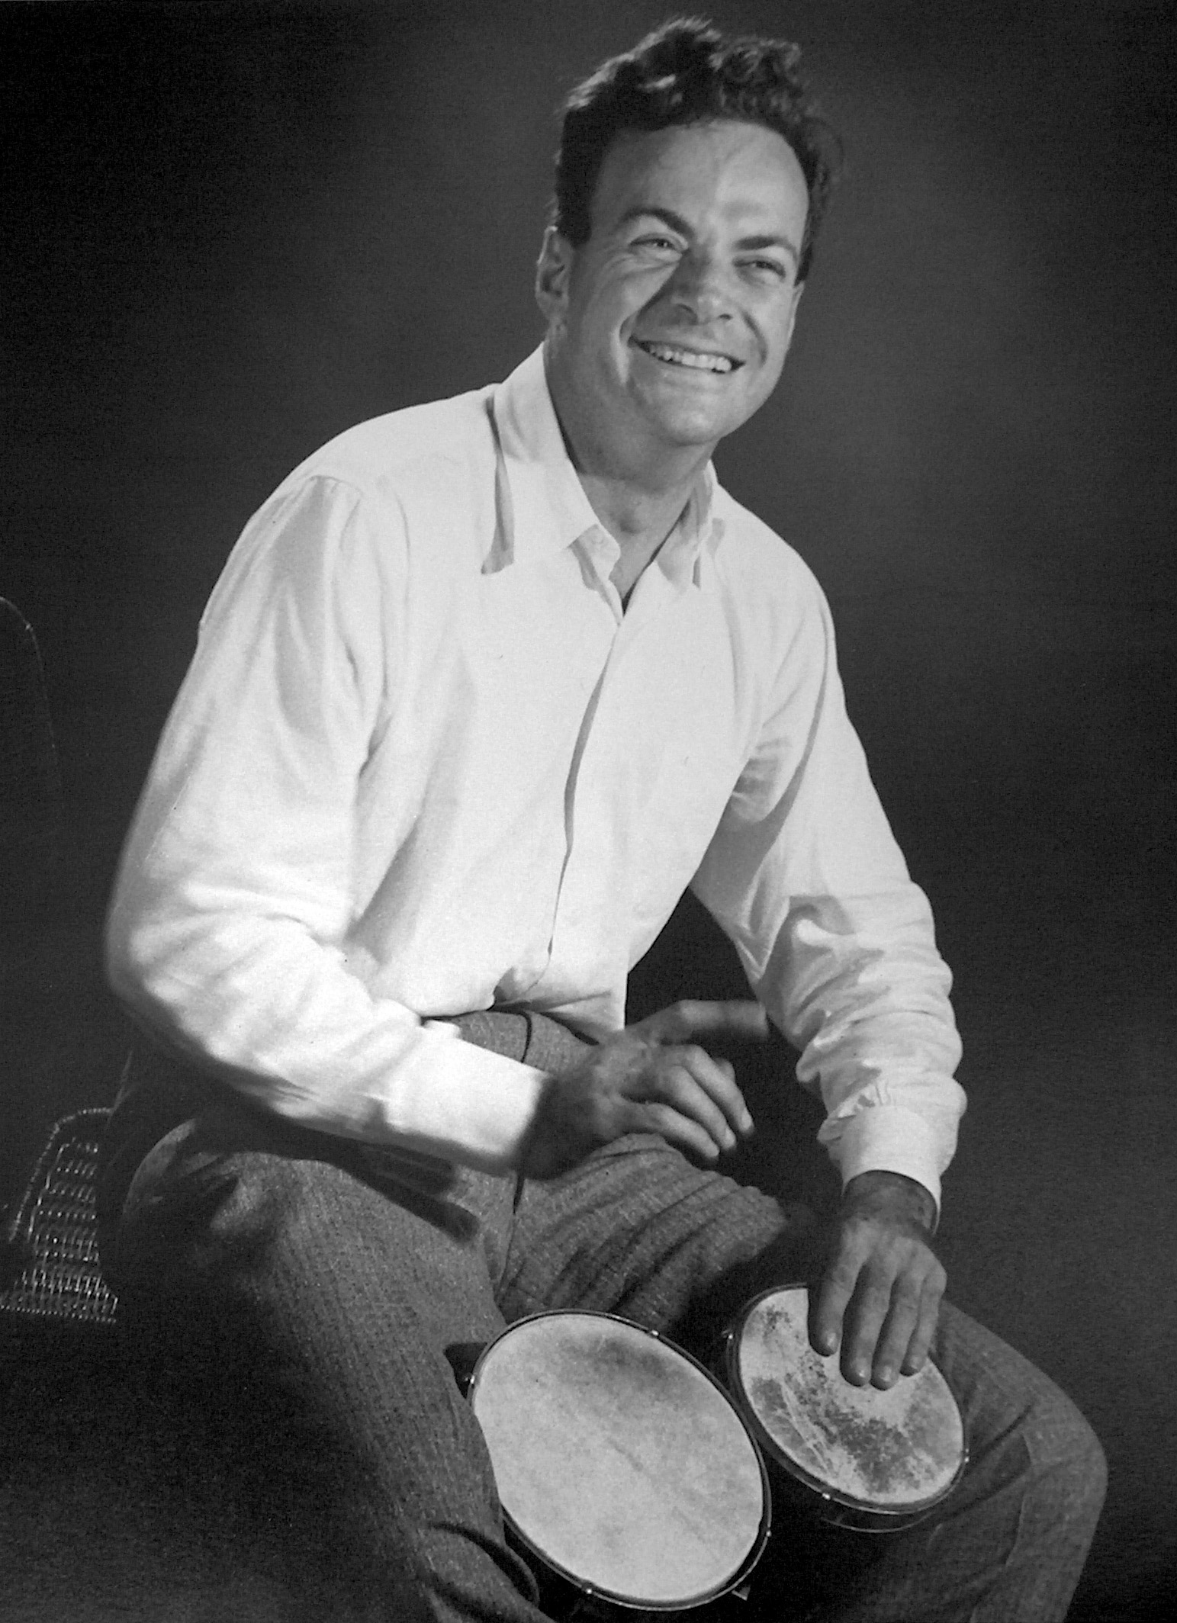
Because Feynman!
WWFD?…
If he had python
If he had the Internet
Notes:
I didn’t know how to do it, but when I asked my boss for help he told me: when you have a problem you don’t know how to solve, step aside and ask yourself: What would feynman do?

Slide 13
"Study hard what interests you the most in the most undisciplined, irreverent and original manner possible.”
Notes:
I tried to turn the peculiar way that Feynman had of looking at the world into features of my software, which I will explain in the four chapters of my tale about data kung fu.
Through this presentation you will find some of the Feynman quotes that inspired me to build Shaolin.

Slide 14
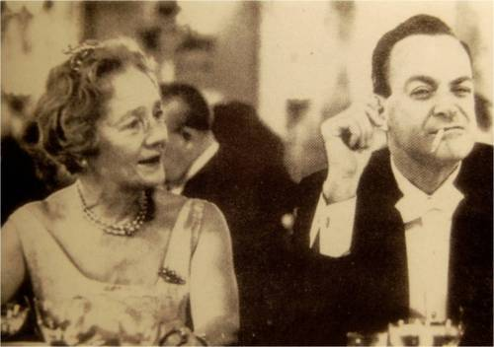
Chapter 1: Science
“Science is the belief in the ignorance of experts.”
Notes:
My job title is mad scientist, so I should do something to honor that term

Slide 15
Think Science
“Religion is a culture of faith; science is a culture of doubt.”
Notes:
THINK SCIENCE

Slide 16
Doubt + experiment → Model
Notes:
The core of science is about thinking, asking questions and experimenting with Nature in order to gain some knowledge, which we try to express in something we call a model

Slide 17
Pure math is outdated*
Notes:
We’ve been using language plus reasoning, which we call math, to communicate our knowledge for the last centuries with great success, but nowadays

Slide 18
Python is a more clear abstraction to explain language + reasoning
Notes:
We find python a simpler way to explain language+reasoning

Slide 19
Write your models using objects
Notes:
Because if you write your models using code

Slide 20
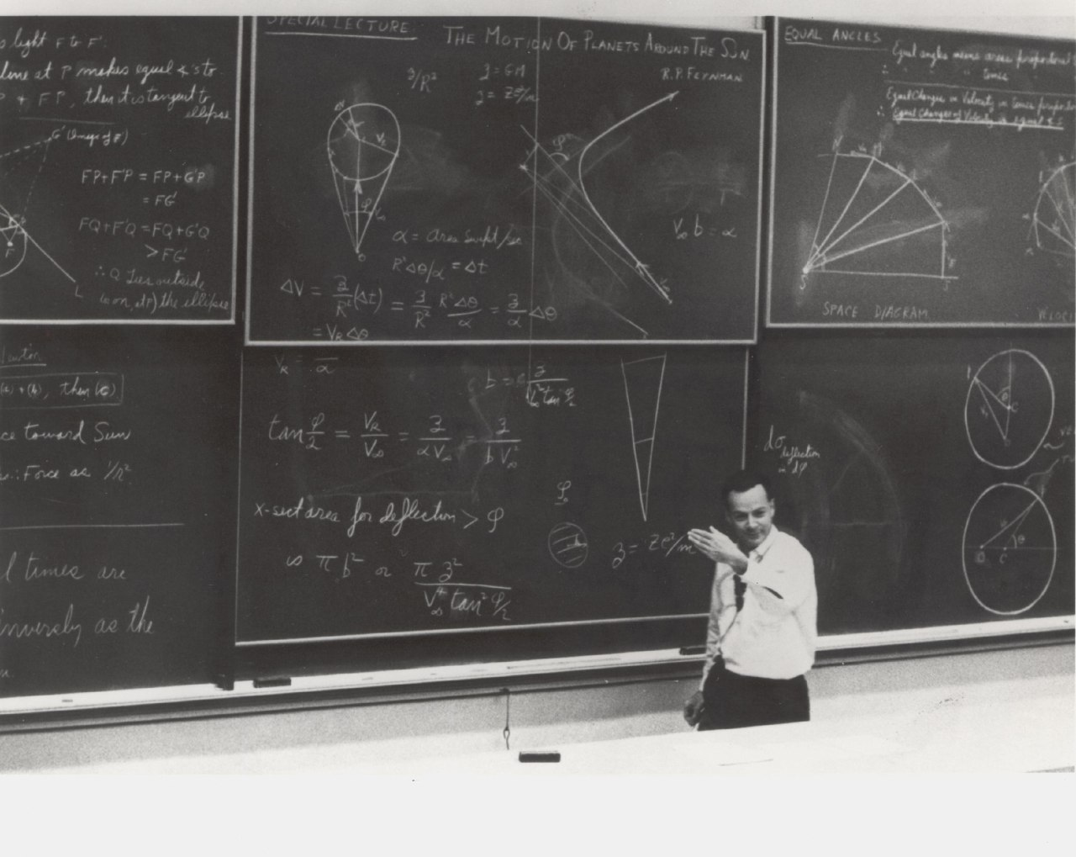
Blackboards?
Notes:
You will find yourself evolving from a blackboard to a

Slide 21
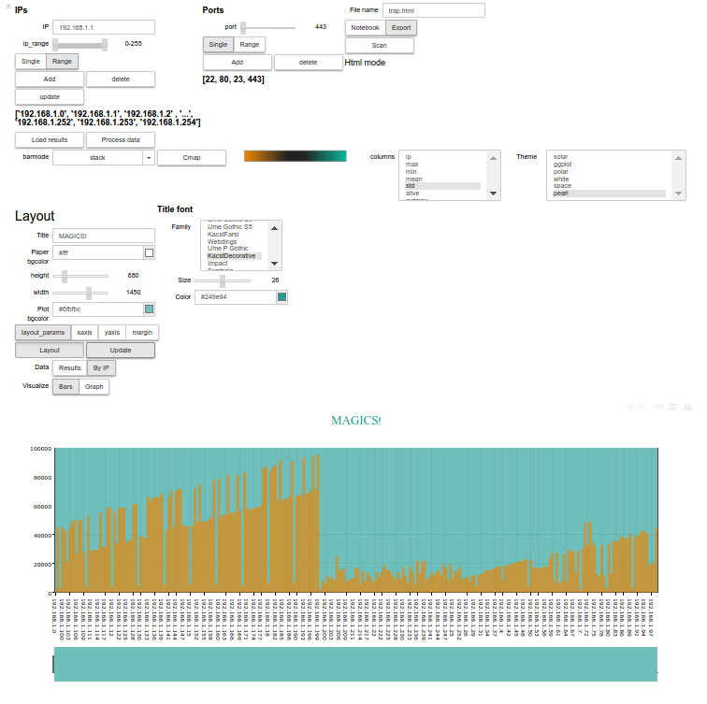
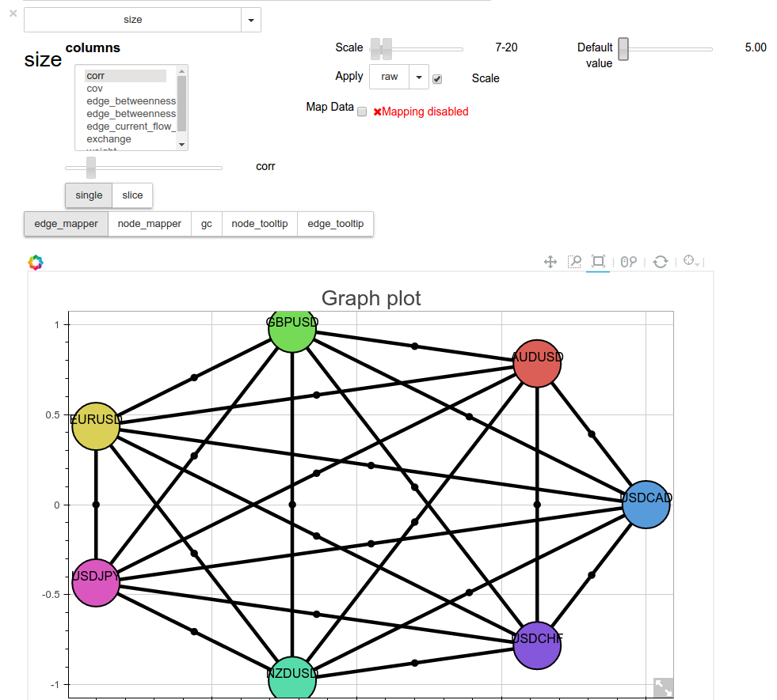
Dashboards!
Notes:
Dashboard

Slide 22
Symplify
“Nature has a great simplicity and therefore a great beauty”
Notes:
Science is also about simplifying. Shaolin aims to bring your code closer to the jupyter notebook by shortening the process of writing complex dashboards with the ipywidgets package

Slide 23
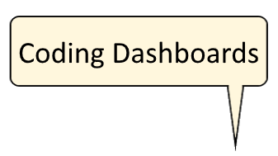
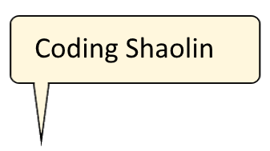
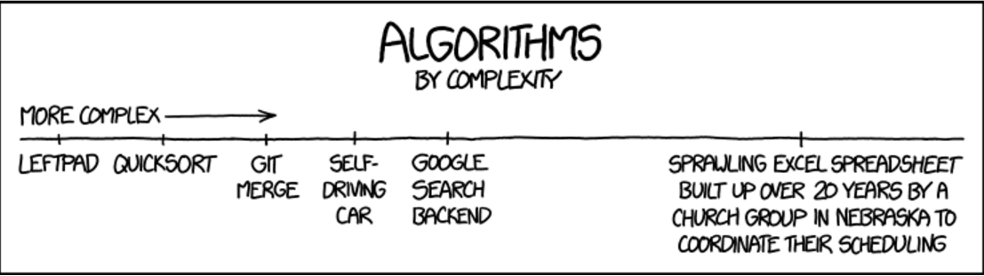
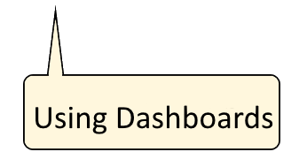
Notes:
Althought its syntax is a bit complex it allows to greatly reduce the amount of code needed to write a graphic user interface, and thanks to the web capabilities provided by the notebook and ipywidgets you don’t even have to know python to use a Dashboard.

Slide 24
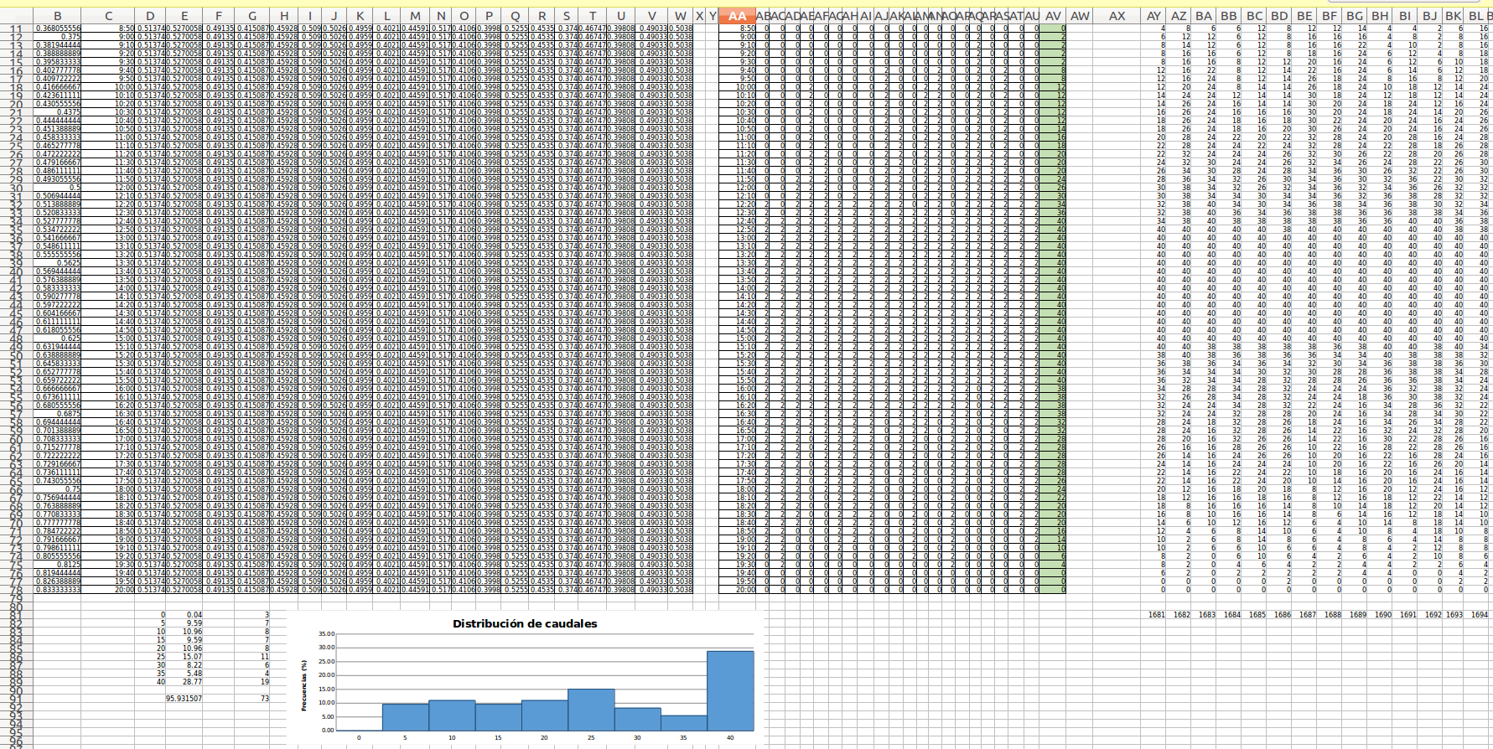
Please...
Notes:
So please, Join me in converting excel models

Slide 25
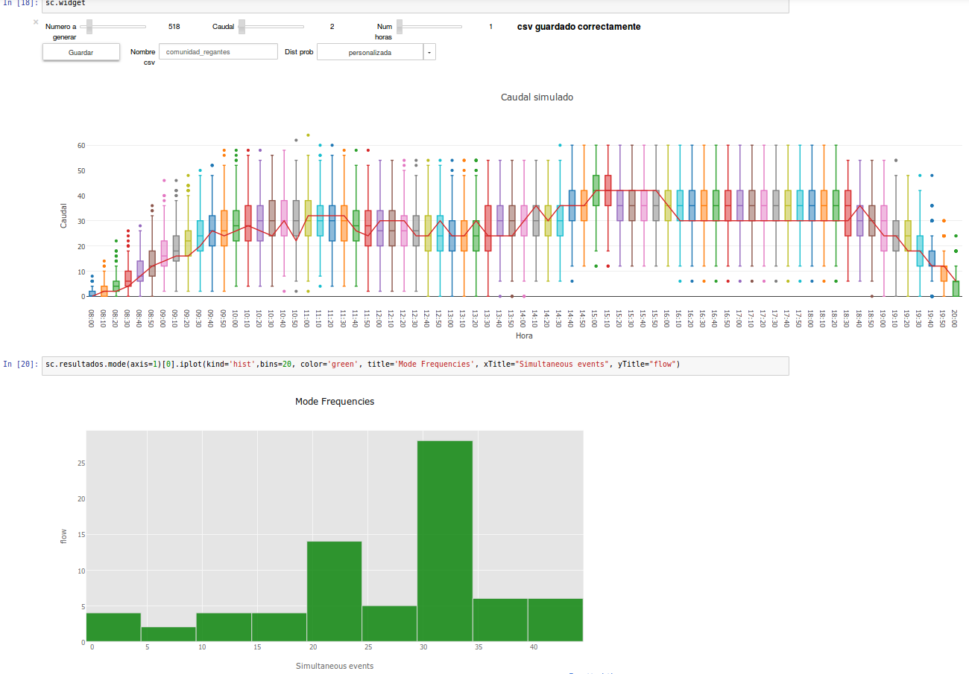
Notes:
Into something more visually pleasing

Slide 26
Shaolin merges OOP with ipywidgets
Notes:
Shaolin achieves this by merging object oriented programming with the ipywidgets package.

Slide 27
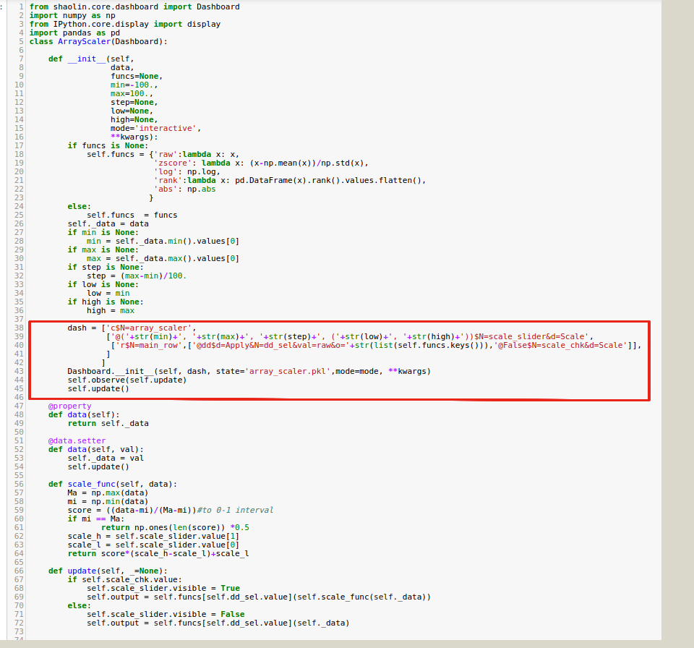
Notes:
As you can see in this example it is possible to define a GUI by inheriting from the Dashboard class and adding the lines of code that you can see inside the red box.

Slide 28
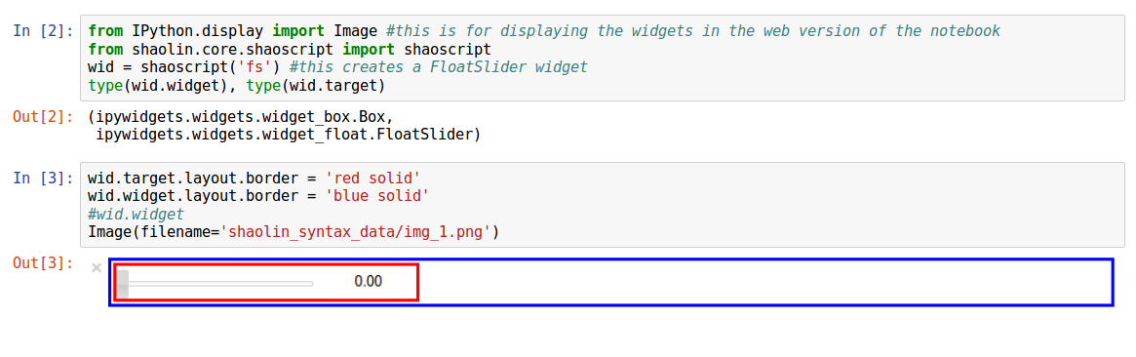
Widgets
Notes:
Widgets are defined by strings formatted in the following way:
first you write the kind of widget you are going to use followed by a dolar sign and then stating its parameters as shown in the picture.
You may find a detailed explanaition of this kind of syntax in the example folder of our github repository

Slide 29
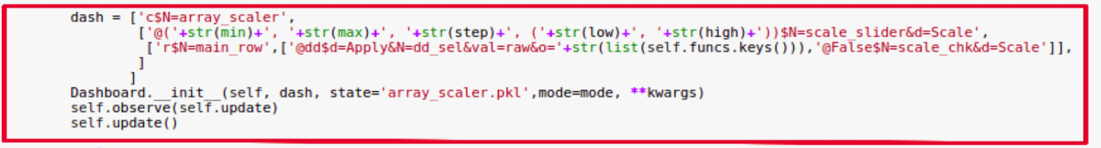
Shaolin Dashboard
Strings for defining widgets.
Nested list for layout boxes.
Inherit from the Dashboard class.
Notes:
If we are using this string syntax we can build nested lists for defining the parent-child structure of the dashboard the same way you would stack ipywidgets boxes

Slide 30
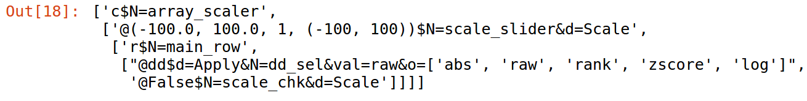
Notes:
Here you can the former example printed as a string.
This c means that our dashboard will consist on a colum.
Its first row will be a IntRangeSlider, which is defined by a syntax mimicking the one provided by the interact function.
Its second row will be comprised of a dropdown and a checkbox widget.

Slide 31
Notes:
Here you have the Dashboard I just explained.
It is basically a Dashboard that scales a numpy array and applies a function to it. This is not something really interesting on its own, but one of the advantages of shaolin is that any dashboard you program will be really easy to combine with other dashboards.
In this example you can see how we can add an interactive plot to our scaler by combining it with another a Dashboard in charge of making matplotlib plots.
If instead of a string you place a whole Dashboard in the nested lists you are using the define a new one,
it will be automagically combined with your new Dashboard as part of its layout and functionality.
This is just an example of how easy it is to create complex Dashboard by object composition.

Slide 32
Notes:
In case you want to build something a bit more complex, shaolin also have a bunch of template Dashboards designed to simplify the coding process.
For example, the colormap picker is a Dashboard that allows to select any matplotlib colormap and seaborn pallete so you will never have to worry about choosing the right color pattern.
Here you can see how it is possible to combine the colormap picker with cufflinks in order to create a plotly bar chart with seaborn color schemes.
It also allows for changing the kind of bar chart we are displaying, and switching among different cufflinks themes, and selecting which columns of our data frame we are going to plot.

Slide 33
Science recap
Think science → Write your models in Python.
Simplify → Write a GUI using lists and strings.
“Scientific knowledge is a body of statements of varying degrees of certainty -- some most unsure, some nearly sure, none absolutely certain.”
Notes:
Quick recap, Shaolin is about bringing your object oriented programming the notebook by just writing some lists and strings

Slide 34
Chapter 2: Judo!
Gentle or Flexible way
“The highest forms of understanding we can achieve are laughter and human compassion.”
Notes:
Judo means “gentle or flexible way” and its basically based on two principles

Slide 35

Be flexible
Notes:
Be always as flexible as possible

Slide 36
Take advantage of your opponent’s strength.

Slide 37
Notes:
Lets see what I mean with flexibility. Here you have a Dashboard that can make a scatter plot from an arbitrary pandas DataFrame, Panel, or even Panel4D. We will be using the well knowns Iris data set.
It is possible to combine a lot of simple Dashboards in order to interactively define how the data is mapped to visual properties of our plot.
We will start by choosing a discrete color palette to distinguish the different species easily.
This was made to comply with the weird plots my boss made me do, like “Hey, can you please drway just the Iris setosa and verscolor? I would like the Iris setosa to be coloured by its petal length and the versicolor to be purple and have its size mapped to its sepal width.
These example dashboards can have its data values changed on the fly without crashing, so they are really easy to pipe-lnie with each other.

Slide 38
Notes:
Ok, this is a pretty flexible tool, but what about taking advantage of you oponnent's strength? Well… I have to admit that I coded all these dashboards at least 3 times.
The last time I coded it it was because when the ipywidgets version 5.0 came out they changed the way to access layout attributes and suddently my 8k lines of code I used to wrirte our dashboards became useless.
I sweared I would never waste time again manually definings css so I mapped all the Layout traitlets of the ipywidgets package and added a way to set any layout attribute using widgets.
This way you can quiclky load, save and modify custom css configurations for the same Dashboard.

Slide 39
Judo Recap
Stack as many widgets as you want.
Data agnostic dashboards.
Widgets for css.
Notes:
Now that the video is over some quick recap:
- Be flexible! Change the data of your dashboards on the fly and use them as black boxes.
- Dont worry about hardcoding css layouts.
Now its time to get serious..

Slide 40

Chapter 3: Be a hacker

Slide 41
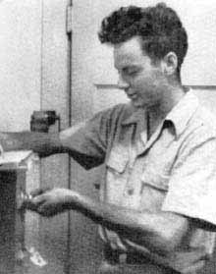
Find your bugs
"It is not unscientific to make a guess, although many people who are not in science think it is"
Notes:
Of course, one of the main skills a hacker has is the hability to find Bugs

Slide 42
Jupyter notebook → Like a charm.
Jupyter_dashboards → Awesome.
Embed, Save → Don’t even try.
Nb_present → Trolling css.
Notes:
One of the main cons of using shaolin is that although it works really well in a standard jupyter notebook and in combination with the jupyter_dashboards extension it doesn’t get along well with the ipywidgets features of the notebook, like embedding an image of the widget or saving its current state easily.
The widgets actually work in the presentation mode of the jupyter notebook but as the css will get messed up you wont be able to use them propperly

Slide 43
Shaolin vs
Interact vs
Caravel
Notes:
Shaolin is just a way of simplifying the task of making your python OOP interactive.
I had to write 8k lines to write the dashboards of this presentations the first time without using shaolin, but once I rewrote them using this framework I was able to finish it with barely 5 thousand
If you are just testing a function interact is your friend, you cannot do better than that, but If you want to fully customize your widgets it is easier to use shaolin.
If you are just aiming to quickly develop a commercial dashboard and please your investors maybe you should use flask and something like the caravel package. Shaolin is meant for science

Slide 44
Information should be free
- Free software for the win!
- Jupyter notebook as the ultimate science-sharing platform.
- Show me the code.
https://github.com/HCsoft-RD/shaolin
Notes:
Shaolin is free software, use it for whatever you want and have fun.
You can find in the github of our company everything you need to get started. In the examples folder you can find a description of all the features shaolin has.
And of course, if you wanna contribute to this project I really appreciate any kind of feedback.

Slide 45

Use it for something different
“What I cannot create I do not understand.”
Notes:
The last part of this chapter is about using things in a different way than intended. For example, in the following demo I show how a dashboard can be converted into a port scanner that takes advantadge of the web browser capabilities by rendering malicious HTML and javascript code.
let’s see how the jupyter notebook can be totally make you feel like a hacker!

Slide 46
Notes:
Shaolin has its own way of saving and loadind the state of its widgets so we can fully customize and share the way our code is displayed.
The greatest thing about shaolin is that dashboards are really easy to reuse., so if you spend time coding a complex plot you will have it avilable for any other dashboard you code.
Here I changed the styling of the notebook and loaded the barplot dashboard with a custom layout configuration.
As you can see almost all the plotly layout capabilities are mapped into widgets.

Slide 47
Be a hacker recap
Load/Save using Shaolin’s own functionality.
Nerd oriented framework.
Free software.
Snowball effect.
Notes:
So if you want to be a hacker load and save your dashboards with the shaolin capabilities.
Remember that shaolin is free software meant for jupyter notebook nerds,
And the more dashboards you have the easier will be to perform complex data analysis in an interactive way.

Slide 48
Chapter 4: Teach & Play
“I don't know anything, but I do know that everything is interesting if you go into it deeply enough.”
Notes:
And we finally arrive at our final chapter:
I call it Teach because shaolin aims to make teaching and learning science easier, and I call it Play because for doing great science you should be..

Slide 49
Have fun
“Science is like sex:
sometimes something useful comes out,but that is not the reason we are doing it. ”
Notes:
Having fun! So now I will have some fun showing you how it is possible to turn an entire pydata talk into a dashboard.

Slide 50
Notes:
This is a tribute of a pydata talk called networks meet finance in python which is presented by miguel vaz. In that talk he transforms the correlation matrix of different time series into a graph and uses graph theory to gain insight in how is information distributed inside a correlation matrix.
In a similar way we can calculate and plot a graph directly from a time series dataframe and use it to display a summary of how these time series behaved during a period of time.
We can assign color mappings to both nodes and edges. In this case we will color each edge, representing a correlation between two timeseries with the coolwarm colormap from matplotlib.
We can use a discrete color palette to easily differentiate each node, or we can assign a color mapping based on a mathematical property of the defined graph like its betweenness centrality.
We can also filter the correlation matrix using a minimum spanning treee or its planary maximum filtered graph in order to quickly gain insight in the mos relevant values of the correlation matrix.
Everything needed to plot a graph with bokeh is already included in shaolin
and almost all the capabilities of the networkx framework are mapped into widgets so can have fun without having to orry about calculating graphs.

Slide 51
Be accessible
“We are trying to prove ourselves wrong as quickly as possible, because only in that way can we find progress.”
Notes:
The last thing I am going to say is that please, try to be accessible. Make it easy to prove yourself wrong and try to get as much feedback as possible.

Slide 52
Final recap
I hope you had fun
Thank you
Feedback time!
Notes:
despedida

